Slide 1
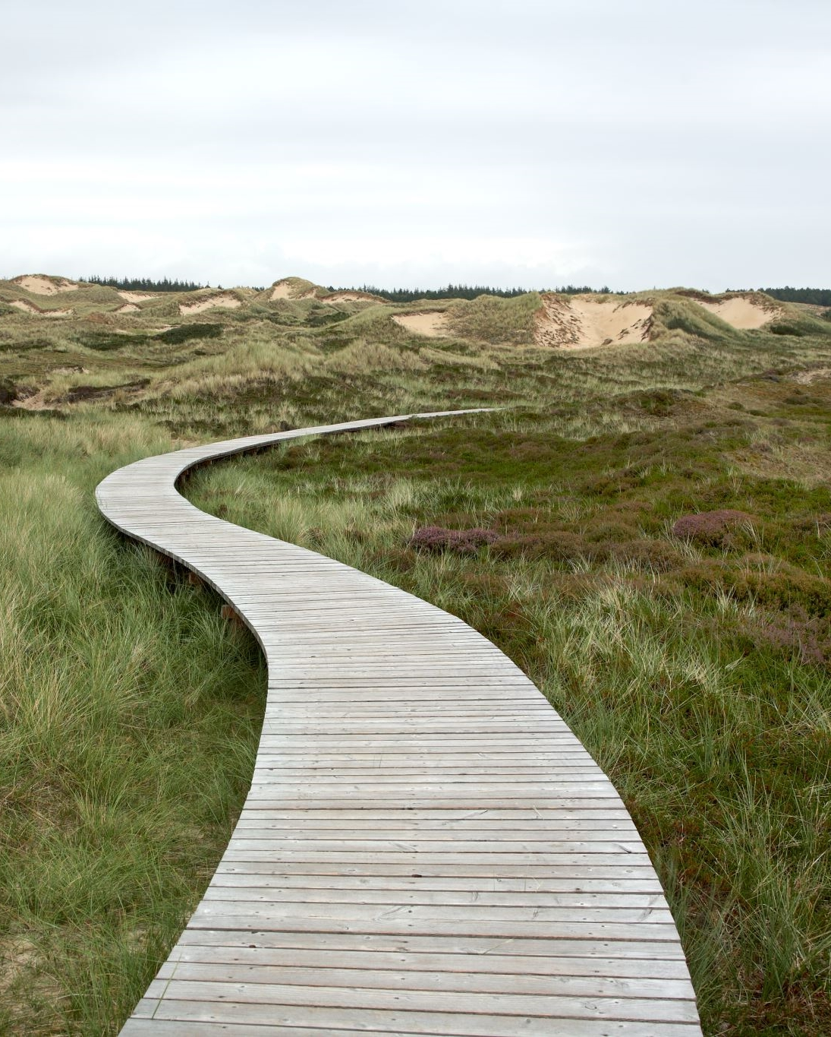
Graphs
Data Structures and Problem Solving
COMP232
Dickinson College
Slides by Prof. Farhan Siddiqui
some alterations by John MacCormick

Slide 2
Graphs
Graph: A finite non-empty set of vertices and a finite, possibly empty, set of edges.

Slide 3
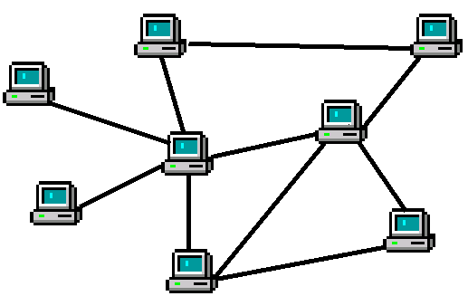
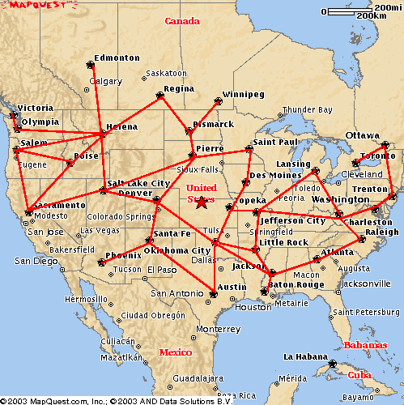
Graph Applications
Computer networks
Transportation networks
Task planning
A
B
F
C
E
D
Notes:
Lots of applications:
Vertices are things, edges are relationships between them...
Computer Networks: vertex == computer, edge == network connection.
Minimum amount of cable to connect all
Shortest path between 2 computers
Transportation: vertex == location, edge == transportation means (road, air route, train)
Shortest route from A to B - google maps
Task Planning: Vertices are tasks - edges are conflicts or dependencies
Can the events be scheduled w/o conflict?
How many time slots would be required?

Slide 4
More Examples of Graph Applications?
Google Maps
Flight Networks
GPS Navigation Systems
Social Media Networks
Facebook
Epidemiology
Neural networks
….. tons of other applications

Slide 5
Graph Notation
Graph: A finite non-empty set of vertices and a finite, possibly empty, set of edges.
G=<V,E>
V = set of vertices
|V| = number of vertices
E = set of edges
|E| = number of edges

Slide 6
Types of Graphs
Undirected Graph
Directed Graph
Weighted Graph
Notes:
Different applications will call for different types of graphs.
Undirected - edges do not have direction.
Directed - edges have direction
Undirected - computer network where information can flow equally well in both directions between two computers.
Directed -
google maps - where there are one way streets -
airlines that fly from NY-LA but not LA-NY (go to LV on way back instead)
Directed graphs can have edges both ways between vertices.
Any undirected graph can be represented as a directed graph by...
Weighted graphs can be directed as well as undirected.
Edge weights can be:
Cost of network cable installation
Driving distance / time

Slide 7
Undirected Graphs
Edges in undirected graphs do not have a direction
i.e. (a,c) = (c,a)
G=<V,E>
V = {a,b,c,d,e,f}
E = {(a,b),(a,c),(a,d),(b,d), (b,f),(c,d),(d,e),(d,f)}
Notes:
What is the minimum and maximum number of edges in an undirected graph?
0 <= |E| <= (|V|*(|V|-1))/2
Every vertex is connected to all |V|-1 others, but that counts every edge twice (i.e. (a,b) and (b,a)) so divide by 2.

Slide 8
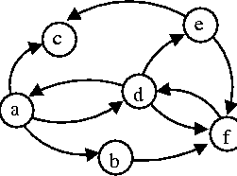
Directed Graph (digraph)
Edges in directed graphs have a direction:
i.e. (a,c) ≠ (c,a)
G=<V,E>
V={a,b,c,d,e,f}
E={(a,b),(a,c),(a,d),(b,f),(d,a), (d,e),(d,f),(e,c),(e,f),(f,d)}
Notes:
Maximum number of edges in a directed graph?
0 <= |E| <= |V|*(|V|-1)
No division by 2 on the number of edges because (a,b) and (b,a) are distinct in a digraph.

Slide 9
Graph Terminology
Neighbors
Vertex Degree:
In degree
Out degree
Paths
E.g. [a, b, f, d, e]
Path length
Simple path
Cycles
Acyclic graph
DAG
Notes:
Degree = number of incident edges.
in degree = incoming edges
out degree = outgoing edges
For Vertex d?
Path - sequence of adjacent vertices
Path length = # of edges in the path (note different from what text did with trees)
Cycle = path that starts and ends at the same vertex
Path here? {a, b, f, d, a}
Length? 4
Any longer? Shorter?

Slide 10
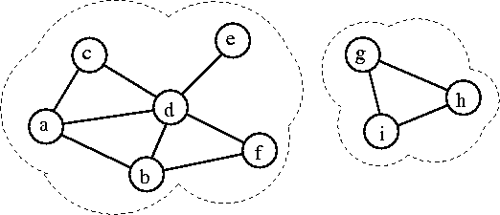
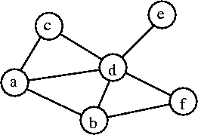
Graph Structures
Connected Graph: A graph in which all vertices are connected:
Connected Component: A maximal connected subgraph of a given graph.

Slide 11
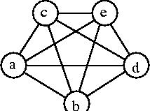
Graph Density
Density: |E| / |V|
Sparse Graph: A graph with a small number of edges relative to its number of vertices.
Dense Graph: A graph with almost all possible edges.
Complete Graph: Graph containing all possible edges.
K_{|V|}: Complete graph with |V| vertices.

Slide 12























Trees
Also known as a free tree.
Contrasts with rooted tree:
A tree is a graph with no cycles
Can easily convert between free tree and rooted tree

Slide 13
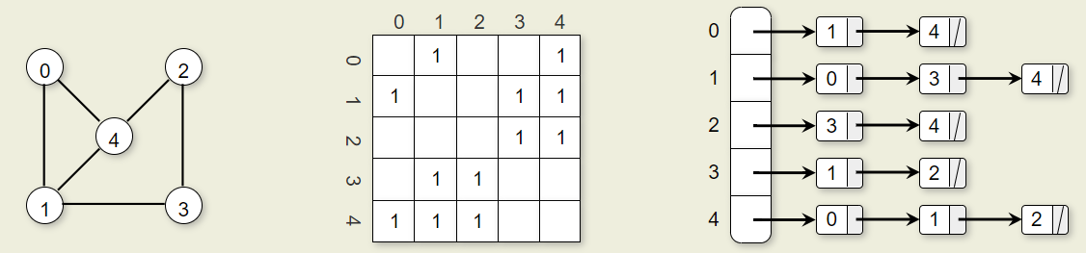
Graph representation: Adjacency Matrix and Adjacency List
Adjacency matrix
(blanks can be filled with zeroes)
Adjacency list
Diagram taken from our textbook, figure 9.1.8

